Slide 1

Board Meeting
September 19, 2024
8:00am
Italian American Club
Watertown, NY 13601

Slide 2
One-Stop Operator/
Provider Report
Customer & Business Satisfaction Surveys: May/June 2024
Feedback was positive on all surveys.
Jefferson County customer surveys = 57
Lewis County customer surveys = 11
Business Surveys for both counties = 24
Lewis County Visit: June 21, 2024
Quarterly Desk Review: 4/1/24-6/30/24
This quarter’s review was of the Disability Resource Coordinator (DRC) program.
Angel Munson

Slide 3
One-Stop Partners Meeting: June 12, 2024
This quarter’s Partners Meeting was held in a roundtable style to allow each Partner to share updates on their organizations. Highlights of the meeting included:
Scott Mathys (Lewis County Opportunities) has a transportation program in place that customers with vehicle repairs. Ms. Hellinger (Lewis County OFA) talked about their Respite Café program and shared that she needs volunteers.
Mr. Ginger (Jefferson-Lewis BOCES) stated that they will be running an EMS program in Lewis County this fall. It is currently a high school program, but they are looking at adult education class offerings as well.
Ms. Marcum (Jefferson County DSS) shared their Transportation Initiative program, which was formerly known as Wheels to Work. They have $14,000.00 to spend by December 31, 2024.
Ms. Munn (Jefferson County OFA) discussed a new program she is rolling out where she is having volunteers call older adults who would like someone to check in on them.

Slide 4
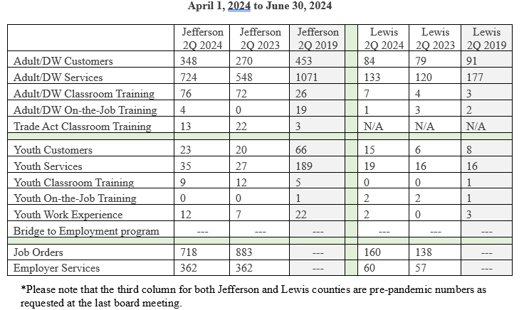

Slide 5


Slide 6
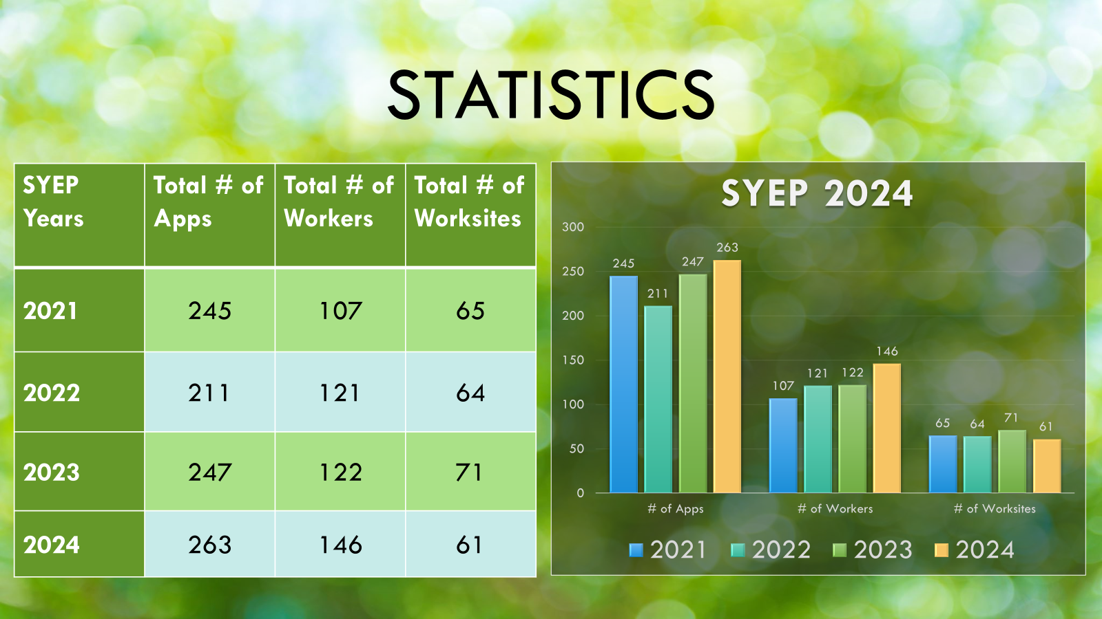

Slide 7
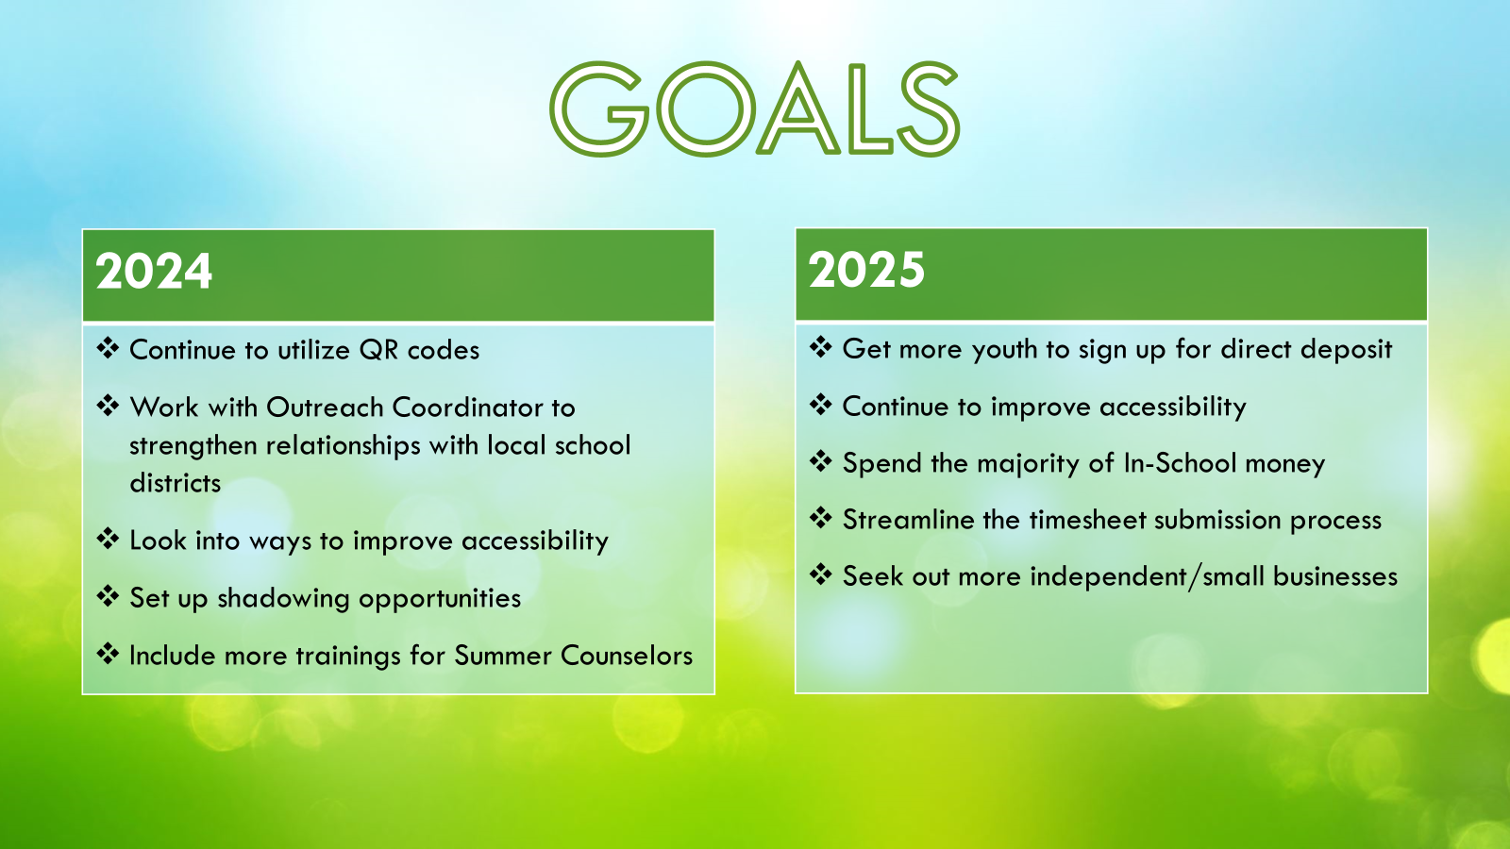

Slide 8
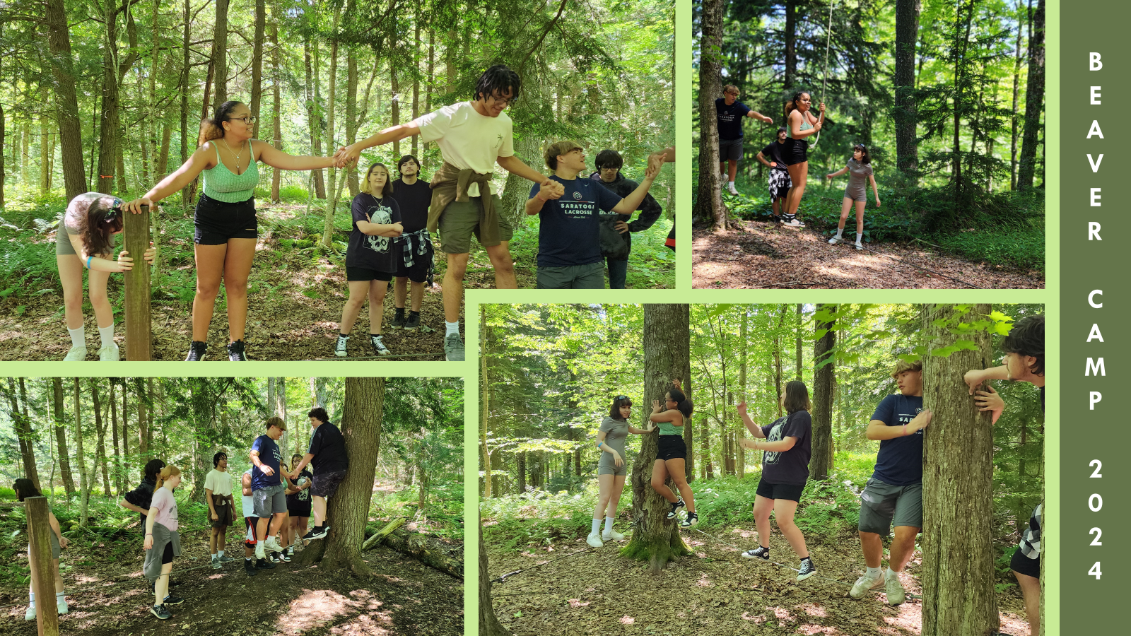

Slide 9
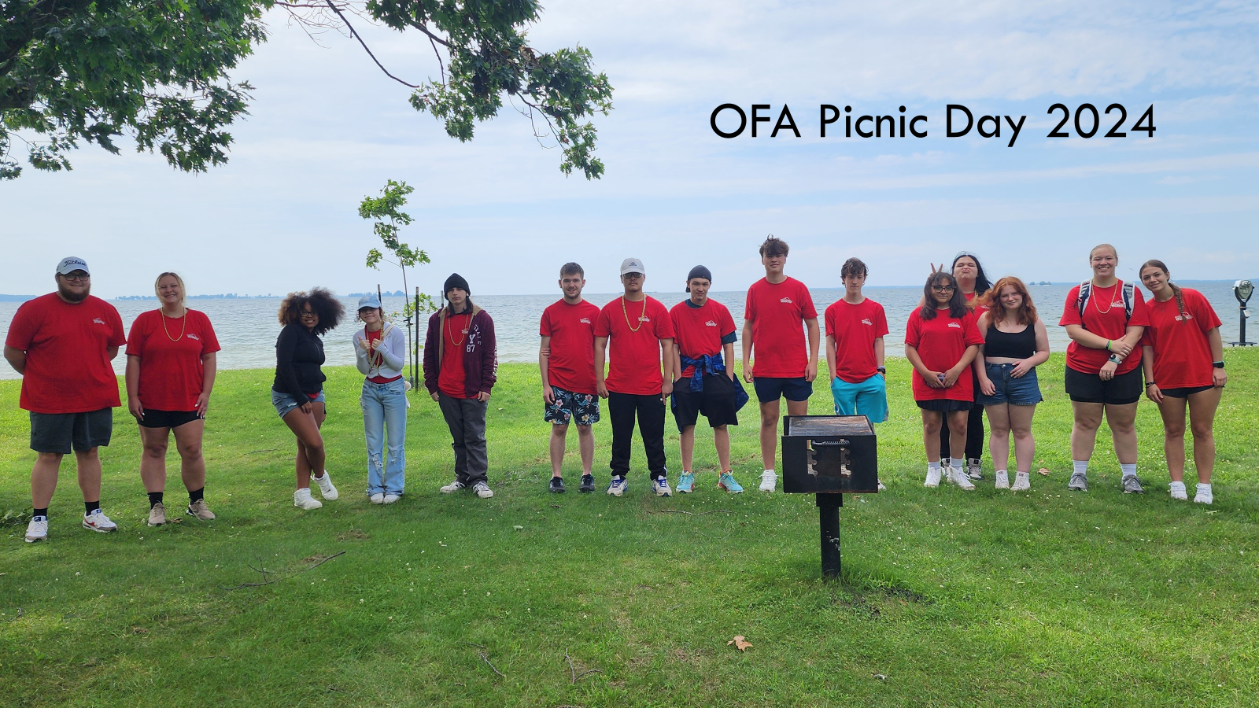

Slide 10
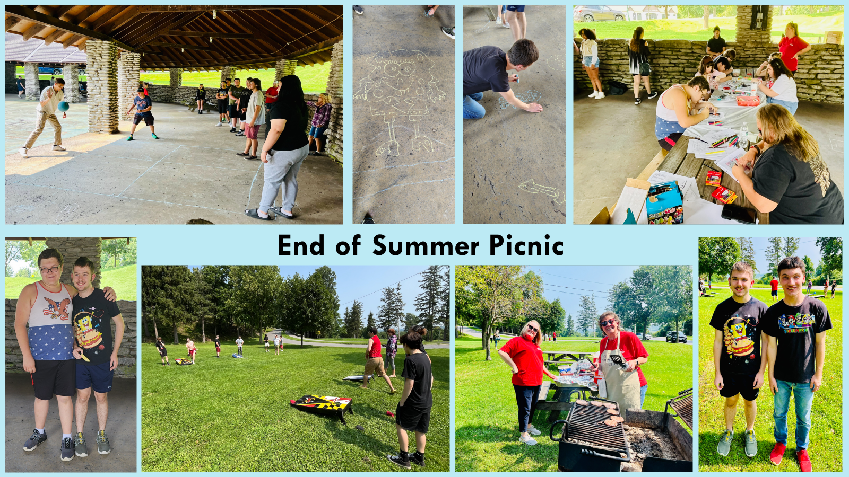

Slide 11
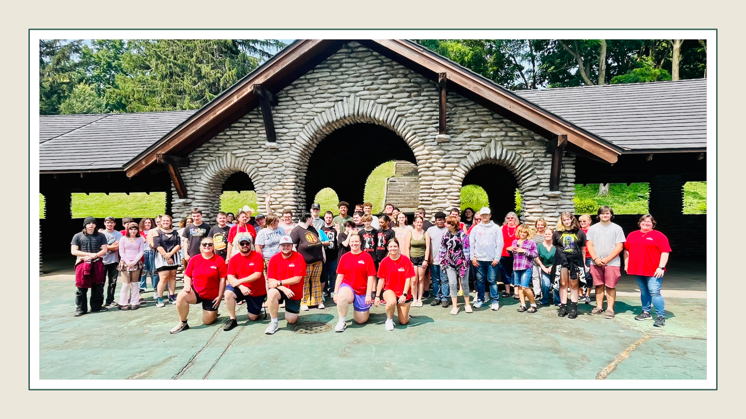

Slide 12


Slide 13


Slide 14
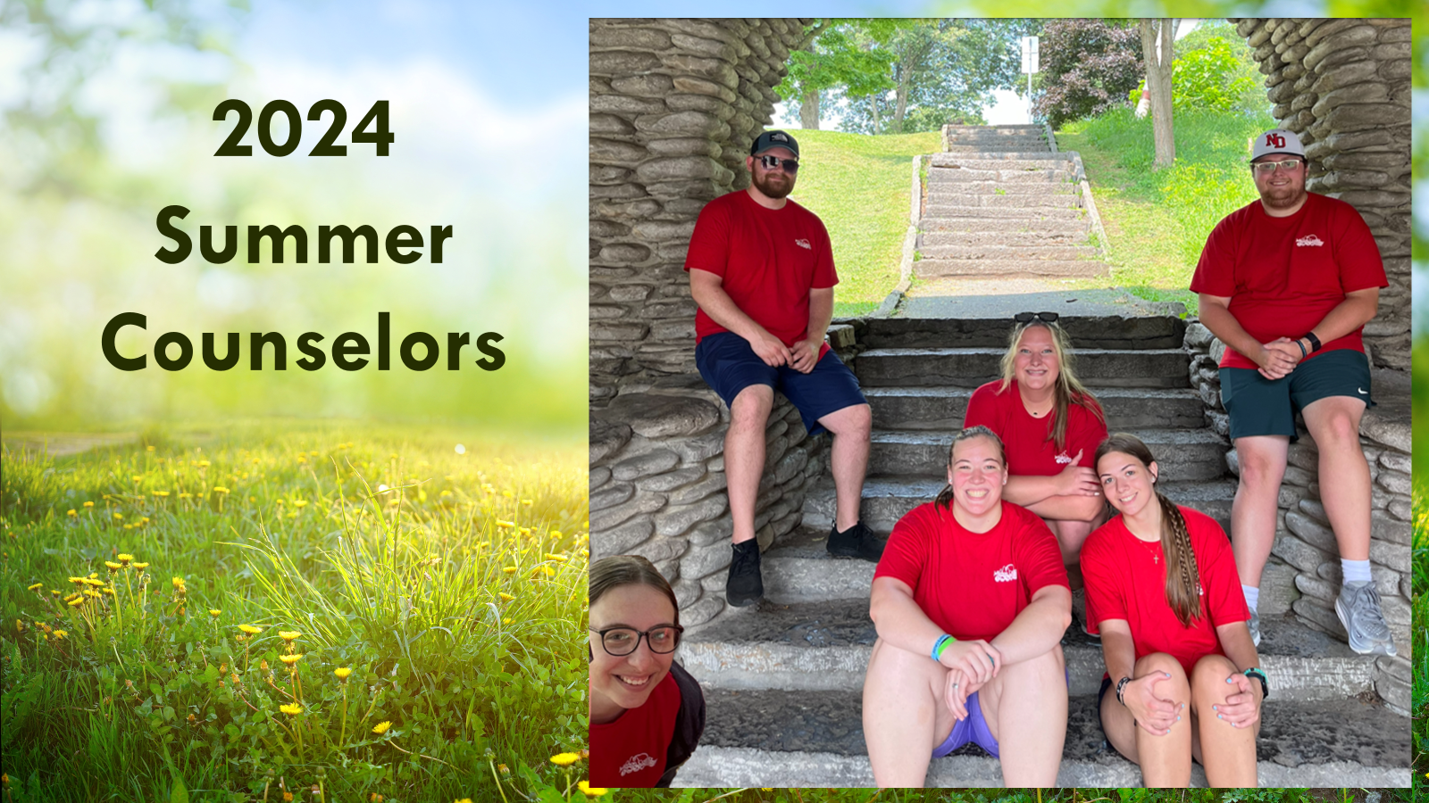

Slide 15


Slide 16


Slide 17
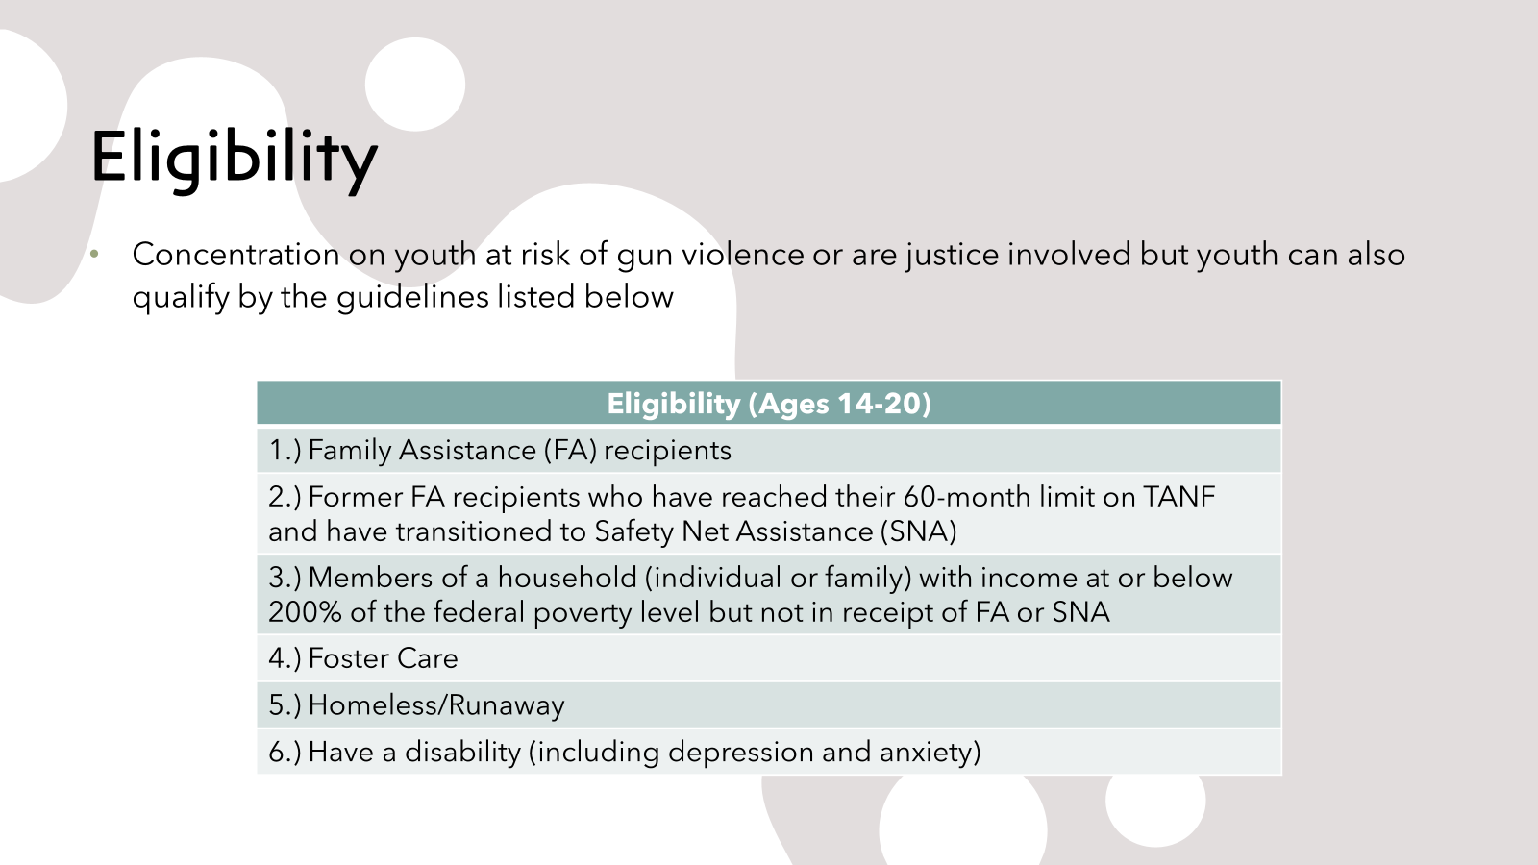

Slide 18
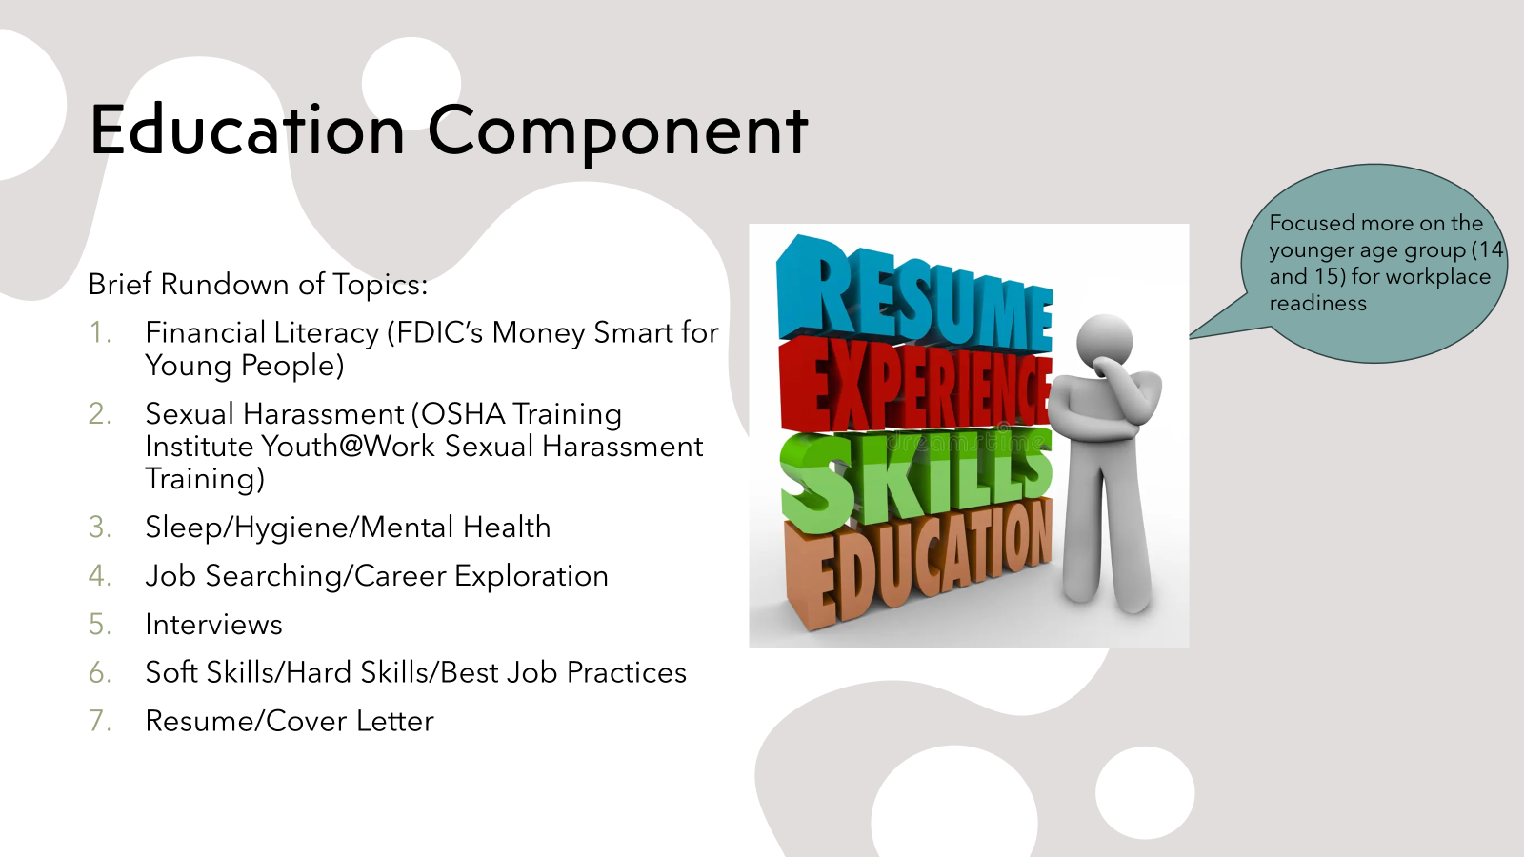

Slide 19
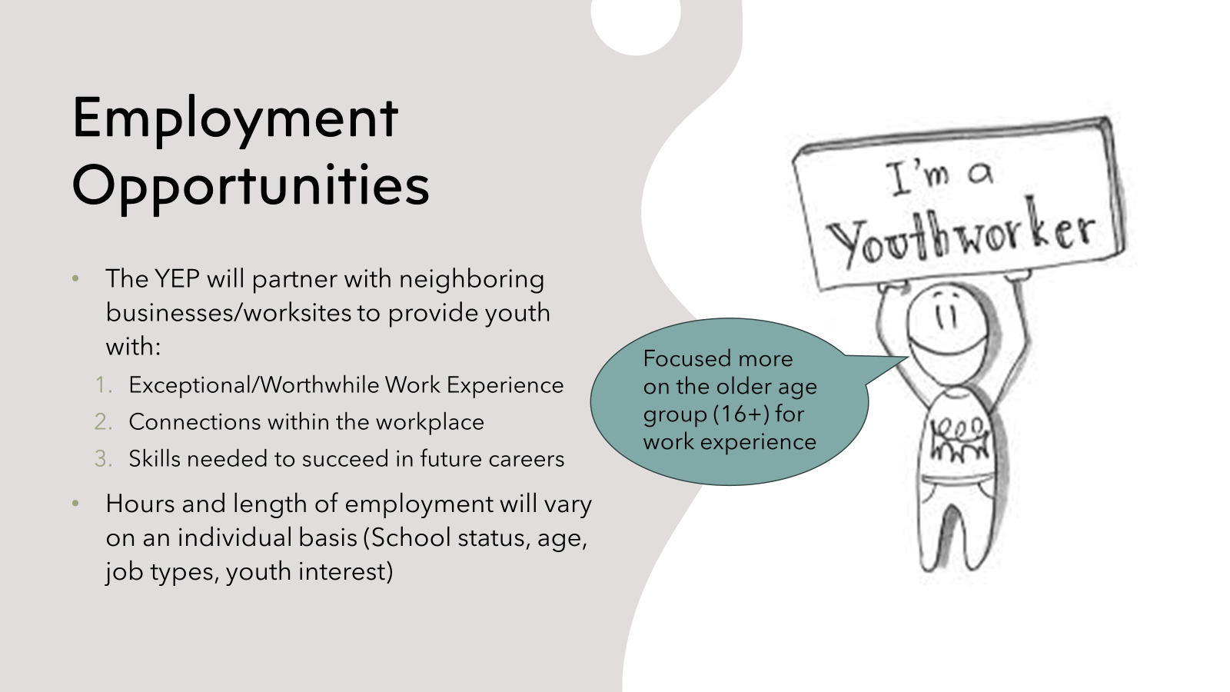

Slide 20
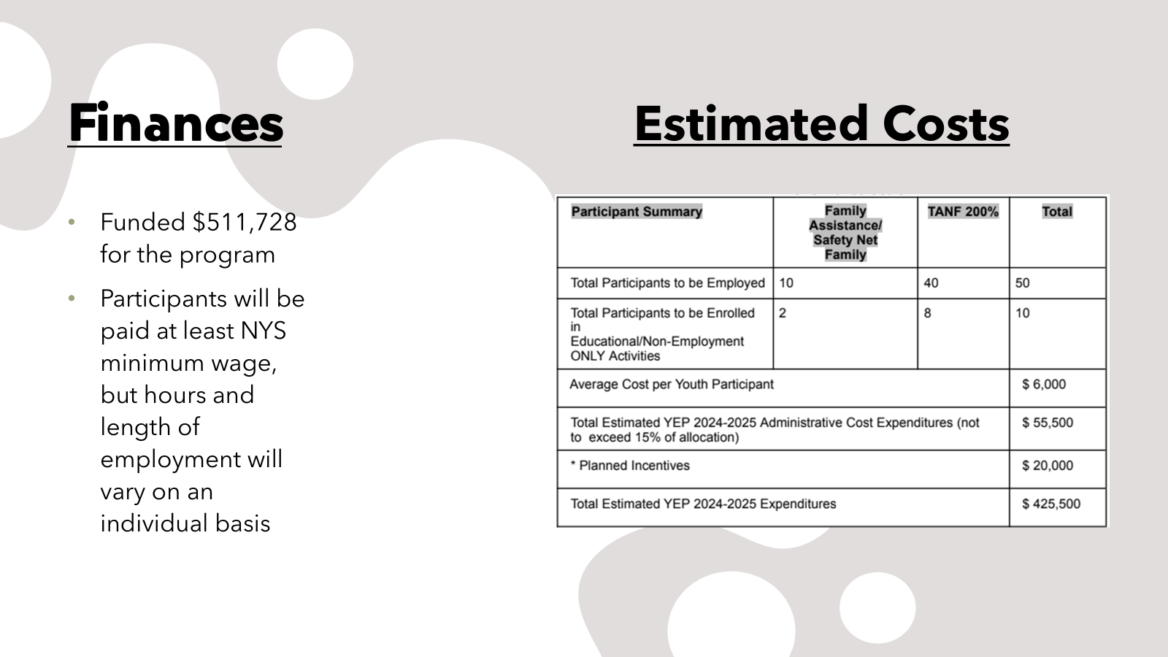

Slide 21
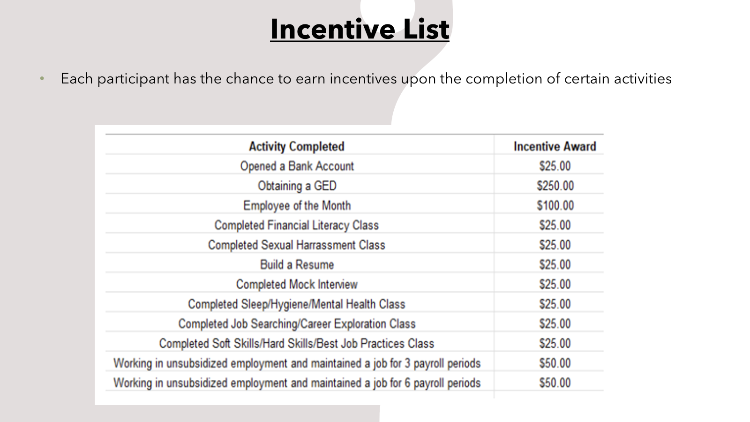

Slide 22
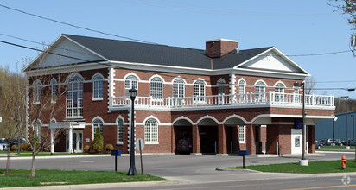
Director’s Report and Financial Report
Cheryl Mayforth, Executive Director
We bought a building!!

Slide 23
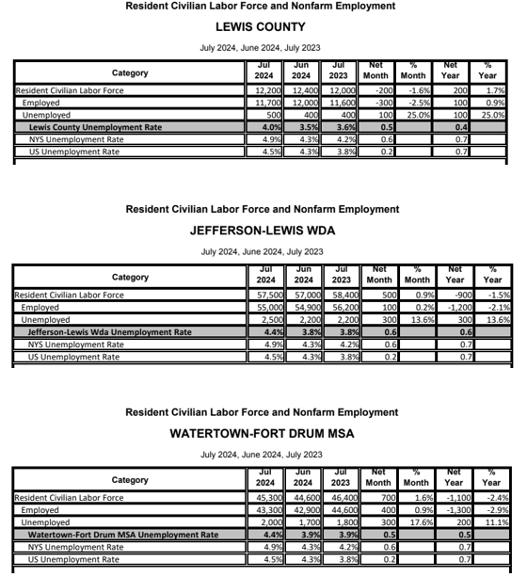
Employment Statistics

Slide 24
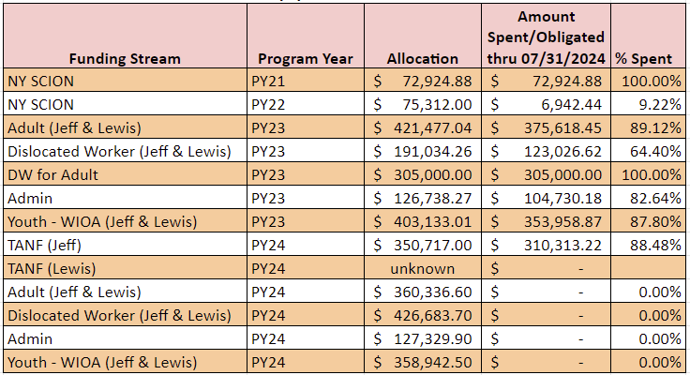
Finance Services Report (per July 2024 monthly reports)

Slide 25
New Business
• Resolution 24-01 Authorizing Use of Perkins Grant Funds for PY24
• Resolution 24-02 Transfer of Funding for PY24
• Resolution 24-03 Recognizing Youth Employment Program Award
• Resolution 24-04 Approval of Youth Employment Program Incentive Plan

Slide 26

Upcoming Events

Slide 27

Upcoming Events

Slide 28

Upcoming Events

Slide 29

Upcoming Events

Slide 30
Next Meeting
December 19, 2024
Hilton Garden Inn
Watertown NY 13601

